Slide 1
MEDICAL TERMINOLOGY AND DRUG IDENTIFICATION
PRESENTED BY:
POOJA SREE BOLISETTY

Slide 2
INTRODUCTION
Medical Dictionary Can Boost The Efficiency And Quality Of Medical Paperwork And Research By Offering An Intuitive And Easily Accessible Interface.
It Can Be Used To Check Up Medical Terminology, Acronyms, And Meanings By Healthcare Workers, Students, And Researchers.
As For Normal Users Who Are Other Than Healthcare Professionals And Researchers It Displays The Drug And Its Available Generic Or Brand Names.

Slide 3
AIM: The Program uses The Data And Displays The Medical Terms, Abbreviations And The Available Alternative Brands To The Drugs. This Will Eliminate The Problem Of Mixing Up Generalized And Medical Terms Which Assists The Healthcare Professionals To Access Only The Medical Terminology. By Searching The drugname It Will Display All The Available Brands In The Market To Purchase.

Slide 4
MODULES USED:
MYSQL
TKINTER
PIL

Slide 5
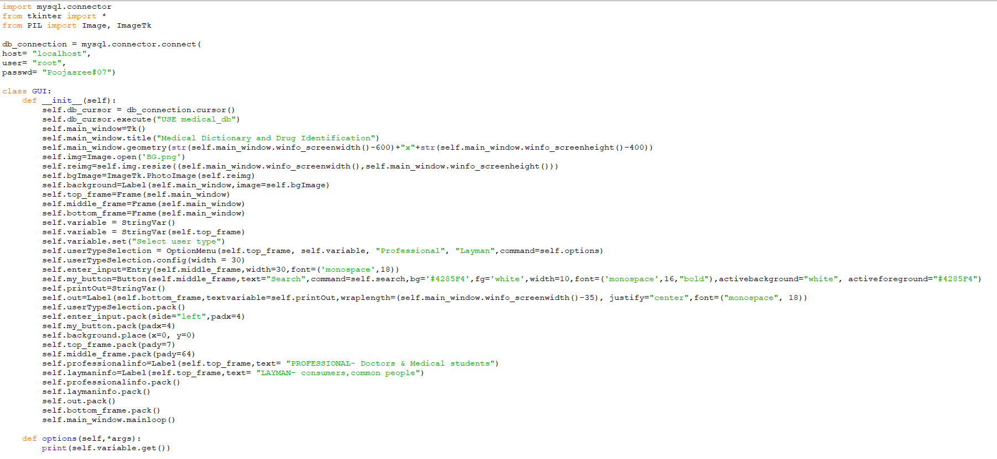
CODE

Slide 6
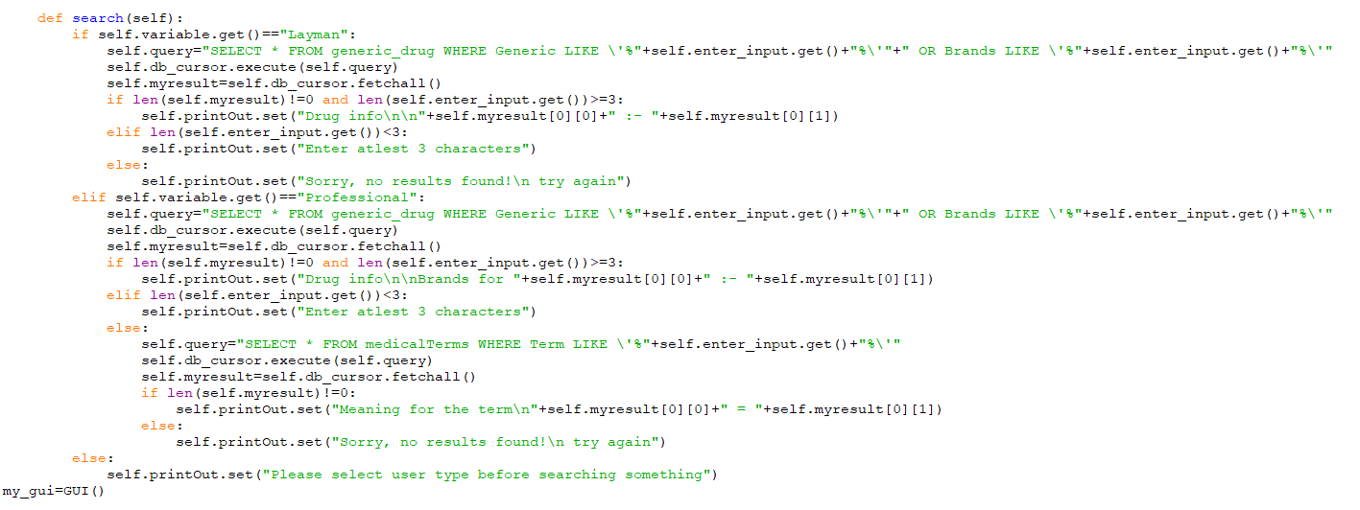

Slide 7
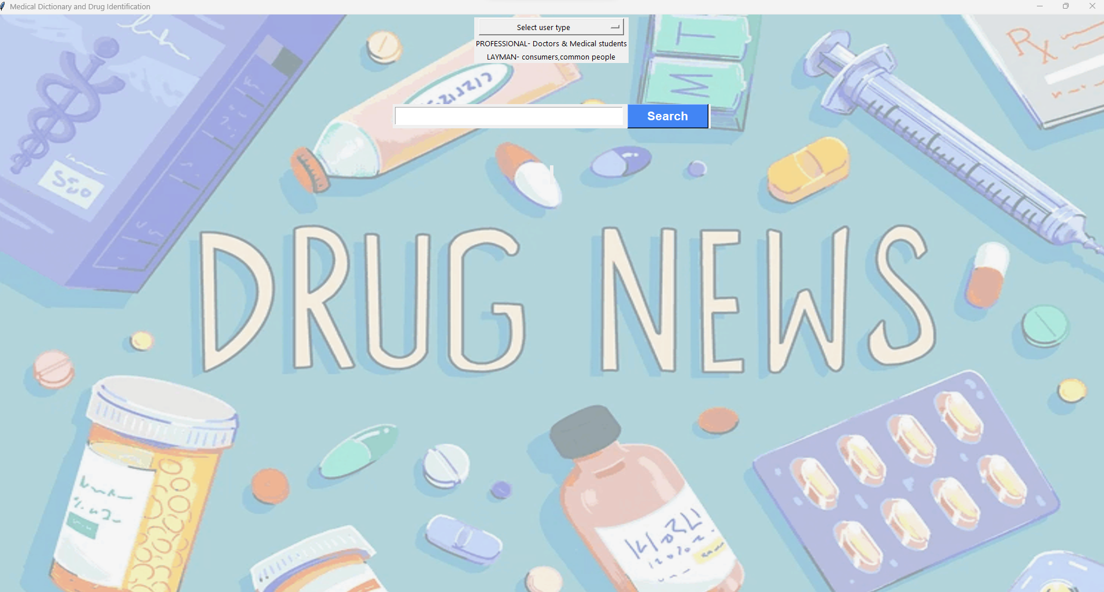
OUTPUT

Slide 8
THANK YOU

